Slide 1
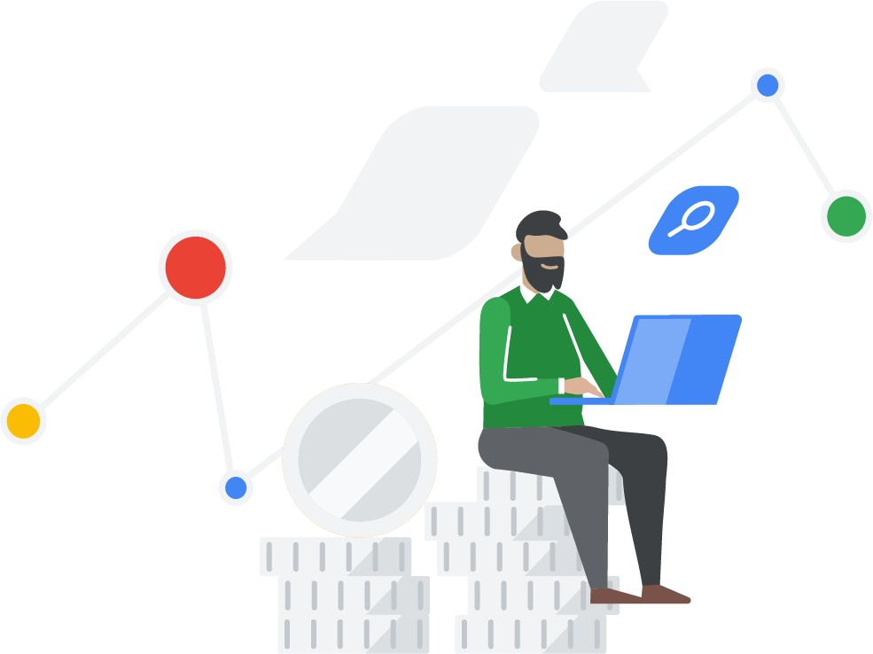
Neo4j Knowledge Graphs and Google Generative AI
Ben.Lackey@Neo4j.com
Director - Cloud Partner Architecture
+1 720 933 9852

Slide 2
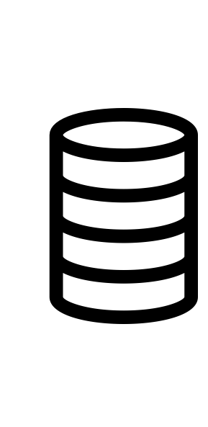
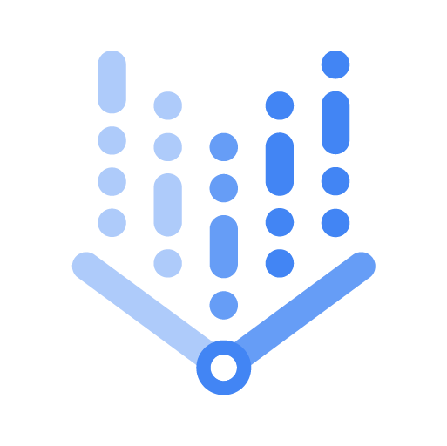
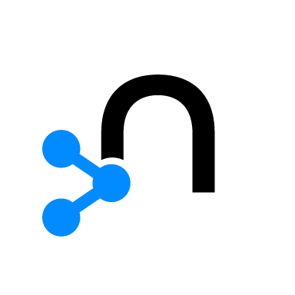

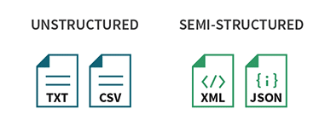


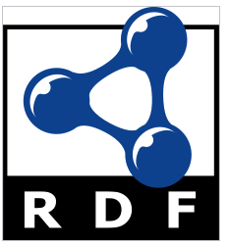
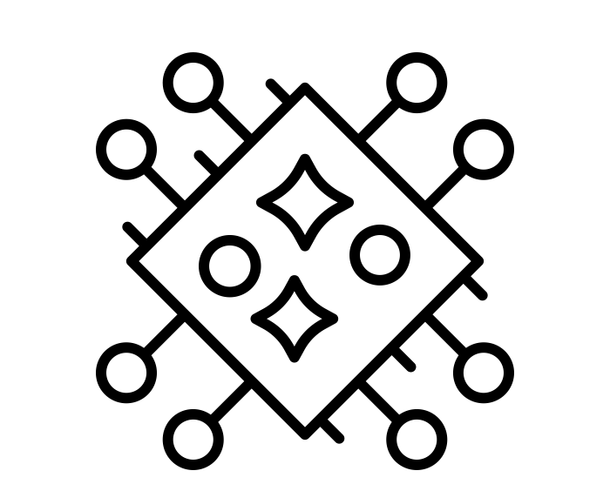
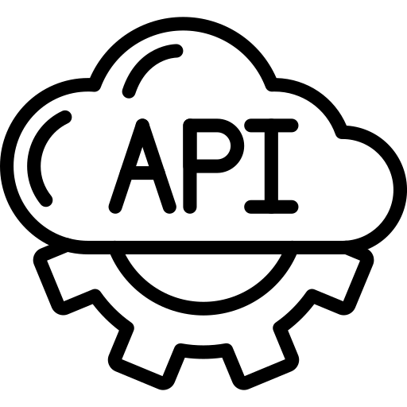
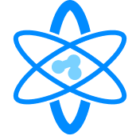
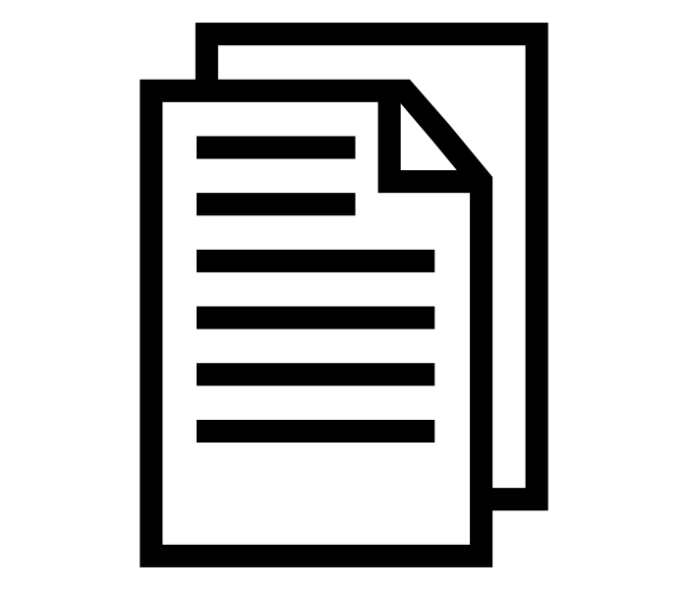
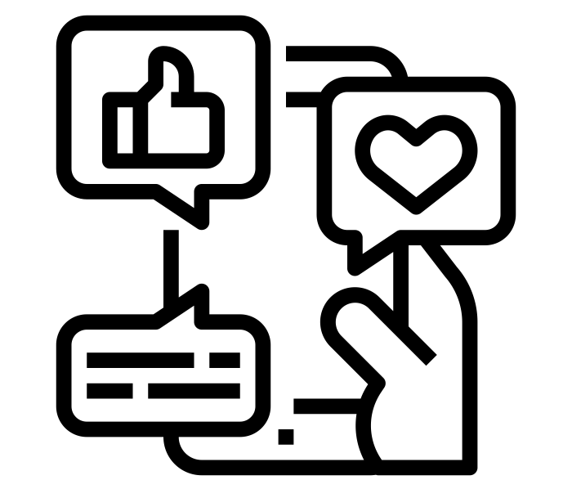
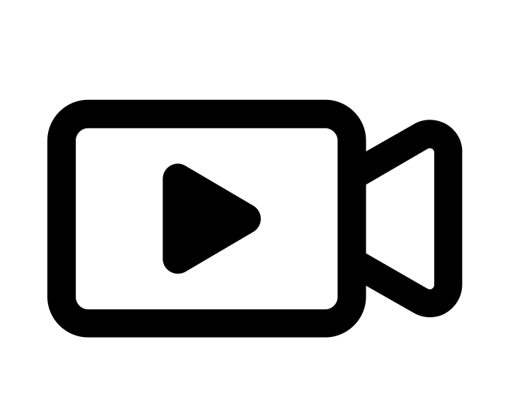
Knowledge Graph and Generative AI Architecture
Knowledge Extraction and Ingestion
Data Sources
Knowledge Graph
GraphRAG
Applications
Neo4j Aura
Enterprise Knowledge Search
Customer Service
VertexAI
VertexAI
Bloom
Ticket Triaging
Structured
Recommendations
News Content & Discovery
Graph DB
FAQ Bots
Patient Prioritization
Ontologies
Clinical Decision Support Systems
Pharmacovigilance
Unstructured
Graph Data Science
Health Assistants
APIs
APIs
Notes:
Enterprises face challenges in managing large volumes of unstructured data. Using only a LLM to interact with your data sources doesn’t give the best results. There is no access control there and tends to hallucinate. So, how can we solve the problem?
Neo4j is a graph database that can connect data from different sources using relationships.
Vertex LLM can extract valuable knowledge from unstructured data with minimal effort even without any tuning in most cases.
By combining Neo4j and Vertex LLM, enterprises can build intelligent applications in a variety of use cases - with full control over data, eliminating hallucinations and improving reliability

Slide 3
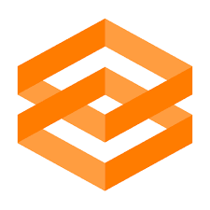

Demo Application - Architecture
Google Cloud
Input Data
Vertex AI Workbench
Gradio Application
Web Interface User
Neo4j Aura
Graph Data Science
Graph Database
Bloom

Slide 4
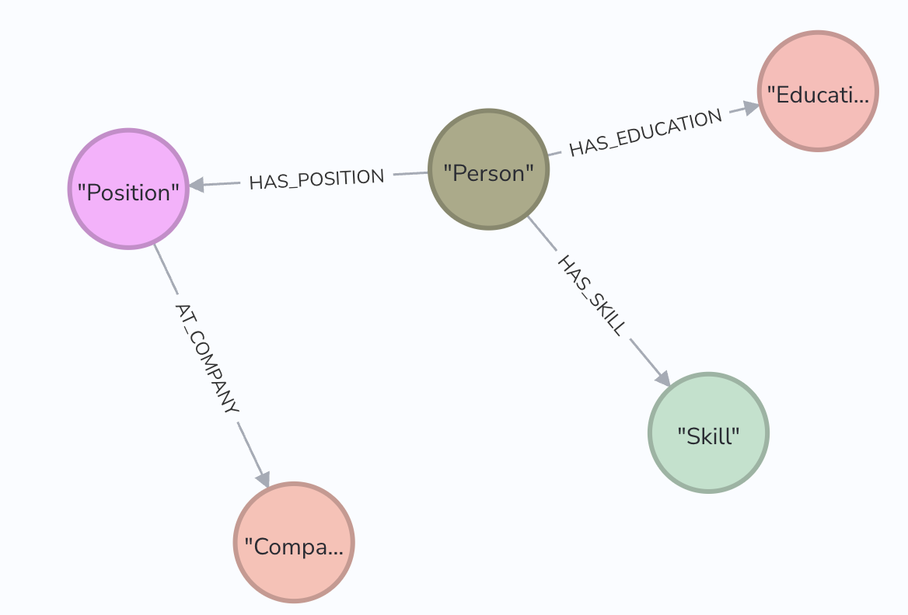
Demo Application - Ingestion
Zero-shot with a simple prompt with text-bison model
Extract Resume corpus information for each person in accordance with a Neo4j Data model

Slide 5
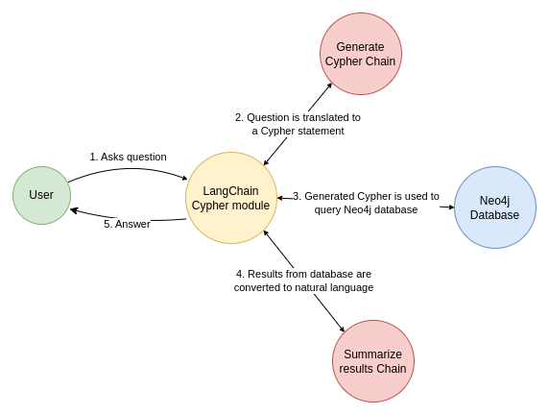
Demo Application - Consumption
Translates English to Cypher
Consumption using code-bison model with few shot prompting
Data augmentation from Neo4j response

Slide 6
Resources
Demo
Ecosystem Page
GitHub
Blog Post
Press Release
Landing Page
Neo4j and Generative AI
Videos
Long Demo - Neo4j Knowledge Graphs and Google Generative AI
Short Demo - Neo4j: How to create knowledge graphs with gen AI
How generative AI is revolutionizing data processing

